Slide 1
Bloom Filters in Python
October 2018

Slide 2

Motivating Example
It’s 1982 - you are at the library and want to see if they have a book on Demogorgons
You go to the card catalog (a type of index) and look up the book
You find they don’t have it
You’ve now saved yourself the hassle of going to the shelves to search for it

Slide 3
What is a Bloom filter?
A space-efficient probabilistic data structure that stores a bit array created off of hashes of the data
It doesn’t store the data itself but can be used to test membership, i.e. “Have I seen this data element before or not?”
False negatives aren’t possible, meaning if I test membership for a data element that was part of the originally hashed set, I will always find it in the Bloom filter
False positives are possible, meaning something can test as in the Bloom filter without being part of the originally hashed set. Fortunately you can specify the rate at which false positives occur. A lower desired false positive rate just means a larger bloom size.

Slide 4
Examples of Bloom filters in the wild
Google Bigtable, Apache Hbase, Apache Cassandra, and Facebook’s RocksDB use Bloom filters to reduce the disk lookups for non-existent rows or columns. This can greatly increase the performance of a database query operation.
The Google Chrome web browser uses a Bloom filter to identify malicious URLs
The website Medium uses Bloom filters to avoid recommending articles a user has previously read

Slide 5
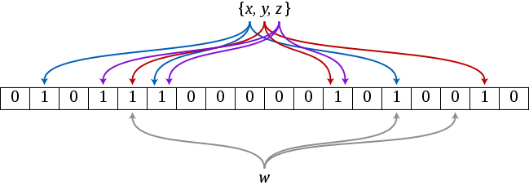
Parameters:
m: bloom size
k: # of hash functions
n: number of data elements to hash
p: desired false positive rate
Ideal m: -(n * (log(p))) / ((log(2)) ** 2)
Ideal k: -log2(p)

Slide 6
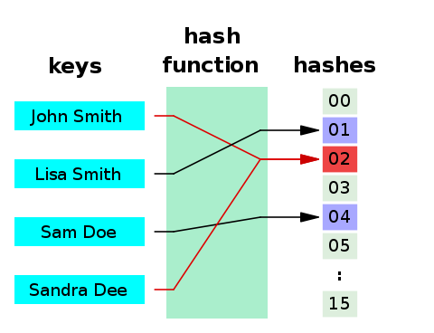
Quick aside: What is a hash function?
A hash function is any function that can be used to map data of arbitrary size to data of a fixed size
Hashes are used for many things, including checksums or for secure data transfer on the internet
E.g. the MD5 hash of my name is dd30efd6fac9a9e1179366b9f54db255 in hex representation

Slide 7
Creating a Bloom filter
Given n, the number of data elements to hash, and p, the desired false positive rate, calculate the ideal values for parameters m and k
Create an bit array of size m that is all 0s
Feed each data element through the k hash functions
Mod each of the hash values by the size of the bloom m
For each mod value, set that bit in the bit array to 1
When all data have been hashed, you are left with a bloom filter that has some percentage of its bits set to 1 and the rest still set to 0

Slide 8
Testing for membership
Run a new data element through the same set of hash functions and map it to a bit array
Compare the bit array with the Bloom filter, and if it has any bits set to 1 that are 0 in the Bloom filter, then it is definitely not one of the originally hashed elements
On the other hand, if its 1-bits are a subset of the 1-bits in the Bloom, the element is said to belong to the original set, with the false positive probability p that it isn’t really a member of the set

Slide 9
Example: hashing names
Bloom filter of size m=20
Initial state: 00000000000000000000
Number of hash functions k=3
Hash functions (using Murmurhash3):
mmh3.hash("Jason Gunnink", seed=1) % 20 = 16
mmh3.hash("Jason Gunnink", seed=2) % 20 = 1
mmh3.hash("Jason Gunnink", seed=3) % 20 = 13
Bloom filter state after adding my name:
01000000000010010000

Slide 10
Add a second person
Second datum: “Ruben Thompson”
Hash functions:
mmh3.hash("Ruben Thompson", seed=1) % 20 = 12
mmh3.hash("Ruben Thompson", seed=2) % 20 = 8
mmh3.hash("Ruben Thompson", seed=3) % 20 = 12 again
Bloom filter state after adding Ruben:
01000001000110010000

Slide 11
Test for membership
New element “John Smith”
Hash functions:
mmh3.hash("John Smith", seed=1) % 20 = 15
mmh3.hash("John Smith", seed=2) % 20 = 2
mmh3.hash("John Smith", seed=3) % 20 = 0
Bit array for John Smith:
10100000000000100000
01000001000110010000 – Compare: “John Smith” not in bloom

Slide 12
Bigger example
235,886 English words in /usr/share/dict/words, a file on many Linux distros
Build a bloom filter on 70% of the words
For the remaining 30%, check membership in the bloom and calculate the false positive rate
<Python Demo>

Slide 13
References
Bloom filters:
https://en.wikipedia.org/wiki/Bloom_filter
https://bugra.github.io/work/notes/2016-06-05/a-gentle-introduction-to-bloom-filter/
https://blog.medium.com/what-are-bloom-filters-1ec2a50c68ff
Hash Function:
https://en.wikipedia.org/wiki/Hash_function
Murmurhash3:
https://en.wikipedia.org/wiki/MurmurHash
https://pypi.org/project/mmh3/
Bitarray:
https://pypi.org/project/bitarray/
Using Bloom filters to de-duplicate internet messages at a massive scale:
https://segment.com/blog/exactly-once-delivery/

